Slide 1
Parallel session
Basic education policy
Martin Gustafsson
Stellenbosch University
Department of Basic Education
Kolosa Nonkenge
Department of Basic Education

Slide 2
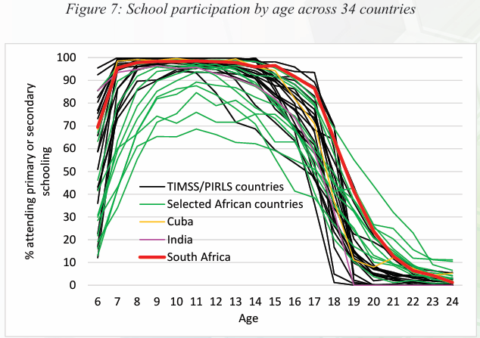
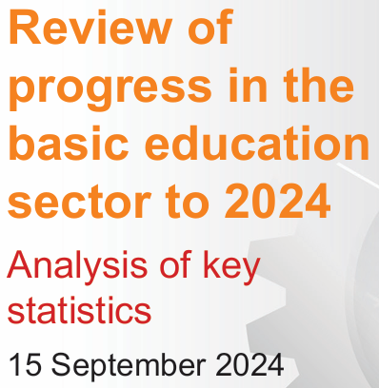
Participation
A country that has been exceptionally good at achieving participation. This is part explains our relatively high education spending over GDP ratio.
From 2024 sector review of DBE (on DBE website).

Slide 3
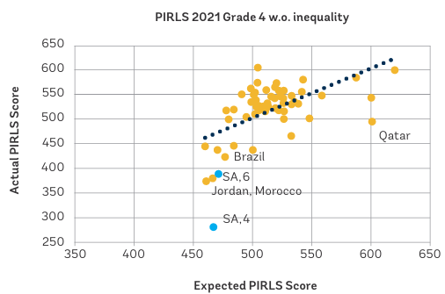
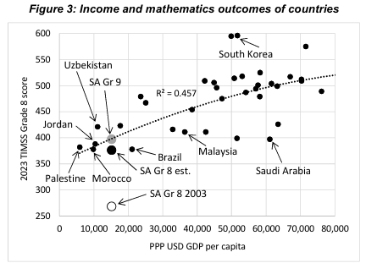
Quality of learning
Unpublished from TIMSS 2024 data.
From 2025 World Bank SA Economic Update.
A country widely reported to be a quality outlier, though 2024 TIMSS shows that at the secondary level we have ‘normalised’.

Slide 4
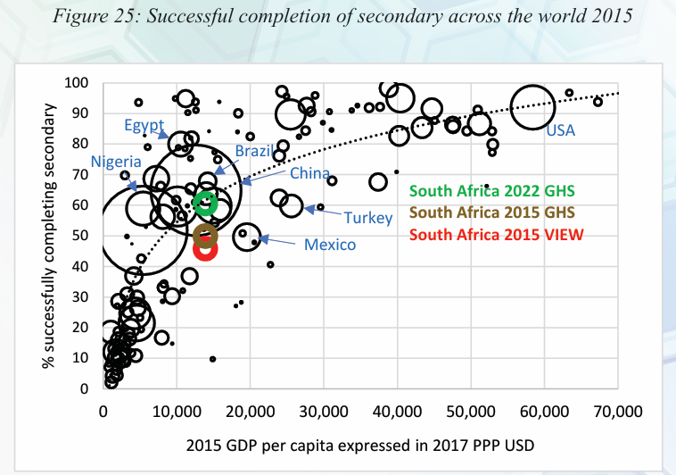
Grade attainment
Or ‘grade survival’ or ‘throughput rate’ or ‘dropping out’.
Previously, a Mexico-like under-performer, but paradoxically the pandemic pushed us to the norm, where we have stayed.
From 2024 DBE sector review.

Slide 5
Questions of strategy we ask too seldom
How did South Africa become one of McKinsey’s three steep improvers among developing countries post-2000?
How do we balance the focus on three critical areas: (1) pre-school (budgets!); (2) grades R to 3; (3) grades 4 to 6 (language!)?
How do we constructively manage the ‘dropping out fixation’?
What does ‘generating 21st century skills’ really mean in our context?
How do we address the primary-level school accountability gap?
Why do urban black learners under-perform relative to rural black learners with regard to e.g. high-level mathematics results?

Slide 6


THANK YOU!
saldru.uct.ac.za/sa30

